Slide 1
Mobile Security & Privacy Revisited
15-421/08-731 and 46-869 -- Fall 2013 – Lecture 19
Information Security & Privacy
Norman M. Sadeh
School of Computer Science
Carnegie Mellon University

Slide 2
Practical Info
Mini semester:
Grading HW assignment and midterm exams
Hoping to get HW#2 out tonight – otherwise Saturday
Full semester: Project teams to come and see me every other week
Also, go and talk the TA’s: they are very knowledgeable and eager to also help project teams

Slide 3
Outline
Mobile Security and Privacy Revisited
Mobile Device Management
Mobile App Privacy
Concluding Remarks
Student Presentation:
“Mobile Payment Services” by Adam Durity and Ziwei Hu

Slide 4
BYOD & Mobile Security: An Enterprise Perspective

Slide 5
Reconciling BYOD and Security
People need the devices to be productive
Policies that are unrealistic will just encourage employees to circumvent them
Complex tradeoffs
No silver bullet

Slide 6
Very Specific Regulations (US Examples)
Financial Services
SEC Rule 17a-4, NASD 3010: retain and protect integrity of communications
FINRA 11-39 includes provisions for the use of personal devices – requirements apply independently of whether the device is company-owned or employee-owned
Health Care
HIPAA and HITECH – “Protected Health Information” (“PHI”)
Protect private data, including BYOD devices
All corporate email, data and documents has to be encrypted – both in transit and at rest on all devices
Remotely configure and manage device policies
Monitor device integrity
Protection against malware and cyber threats
Up to $1.5M penalty per data breach

Slide 7
What Can We Do?
Malware protection
Mobile Device Management – over the air
Remote wipe, strong passwords, time-outs
Limit BYOD to supported versions of OSs, storage encryption, nb. of failed logins, etc.
May require a transition period
Separate containers for sensitive corporate apps and data
Possibly limit remote wipe to corporate container
Enlist help of phone carriers – e.g. SMS filtering
Educate Users
Continue to follow developments

Slide 8
Mobile Device Management
Support over-the-air configuration and management of mobile devices
Settings, apps, data – a lot more than email & calendar
Monitoring
Allows companies to enforce consistent policies in a BYOD context
Multiple devices, multiple OSs, multiple operators
Both company-owned and employee-owned (BYOD)
Complex tradeoffs between productivity/empowering employees & security
Needs to be supplemented with employee training

Slide 9
MDM Architecture
Server or cloud (SaaS) component: sends management commands to mobile devices
Apps, settings, data, commands
Client component running on the mobile device
Responsible for executing commands received and for reporting
Commands sometimes sent as binary SMS messages

Slide 10
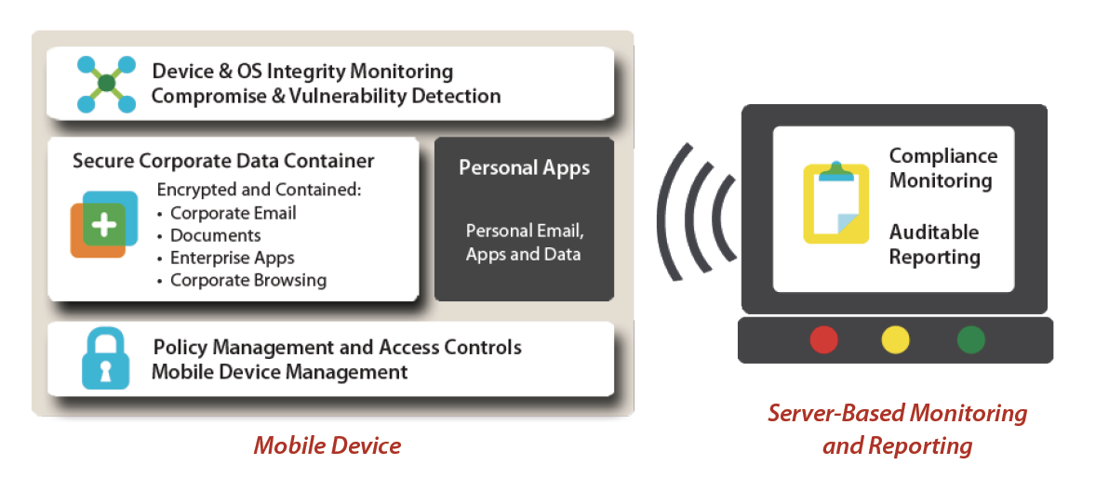
Fixmo: Example of a Product
AES 256 bit encryption
Source: Fixmo

Slide 11
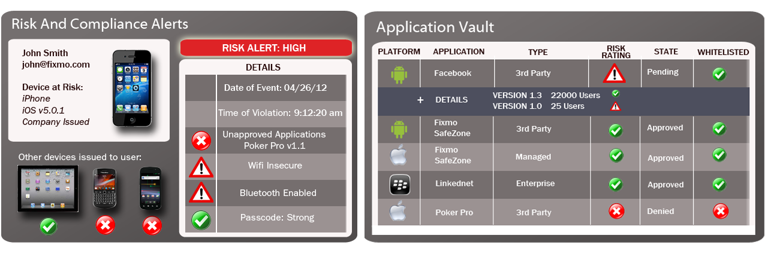
Fixmo Sentinel Integrity Services
Device Integrity Verification & Detection
Automated Response and Exploit Prevention
Forensic Audit Reporting
Source: Fixmo

Slide 12
Fixmo Sentinel MDM
Centrally configures and manages Android, iOS and Blackberry devices
Centralized user and group management – active directory
IT Policy management and security setting configuration
Wireless commands to lock, reset and wipe mobile devices
Device, carrier and location information reporting (GPS location)
Compliance and audit reporting

Slide 13
FixMo SafeZone
Creates secure workspace/container on the smartphone that is encrypted and managed by IT
Corporate email
Corporate documents
Corporate browsing (e.g. intranet, extranet)
Corporate apps (e.g. email, calendar, ERP access)
Secure camera
Can’t move data from consumer side to corporate container or vice versa
Can be wiped remotely
Video: http://www.youtube.com/watch?feature=player_embedded&v=oGXdlOi-B7s

Slide 14
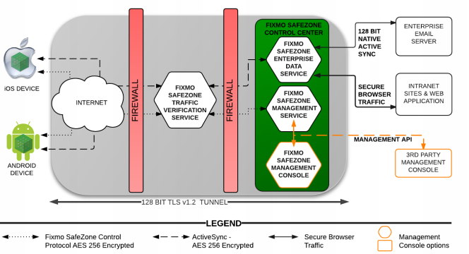
FixMo SafeZone

Slide 15
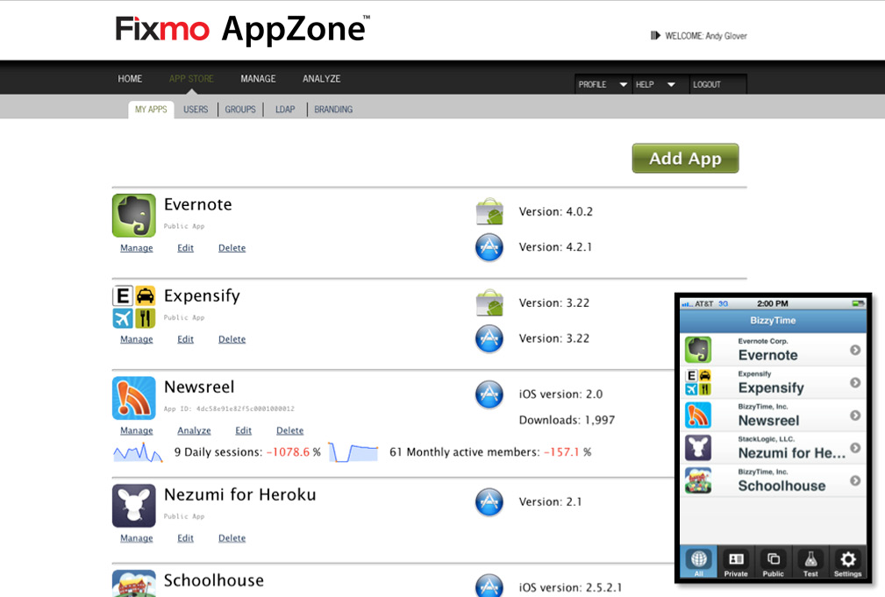
Fixmo AppZone

Slide 16
Understanding the Limitations of MDM
Blurring between private and work life
Many non-corporate apps and functionality can be sources of vulnerability
Posts on facebook
Location via foursquare
Pictures that are geo-tagged
Apps that leak sensitive information
Colleagues that you have sent Gmail emails to
And more…

Slide 17
Mobile APP SECURITY AND PRIVACY

Slide 18




Apps Often Collect More than They Need
Pandora gathers location, gender, year of birth, etc.
Path uploads entire contact list without user full consent.
Brightest Flashlight requires full Internet access, location, etc.
Bible accesses location.

Slide 19
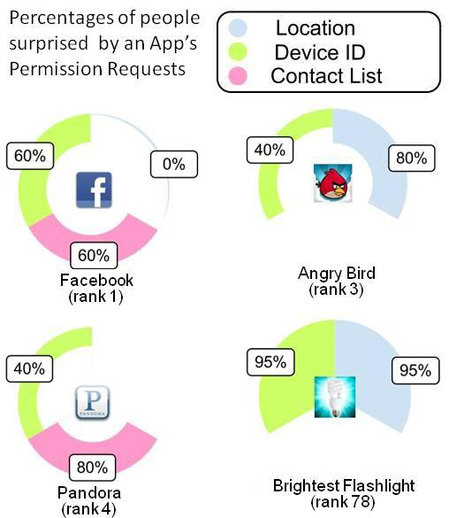
People’s Response When They Find Out…
J. Lin, S. Amini, J. Hong, N. Sadeh, J. Lindqvist, J. Zhang, “Expectation and Purpose: Understanding Users’ Mental Models of Mobile App Privacy through Crowdsourcing”, Proc. of the 14th ACM International Conference on Ubiquitous Computing, Pittsburgh, USA, Sept. 2012

Slide 20
Data Gathering ---- Sept 2012
Create app index
Obtained meta data of 171,493 apps
Both free and paid apps
App name, rating, # of downloads, etc
Icons and screenshots
Download apks and user reviews
108,246 free apps, 13,286,706 user reviews (used in a side-project)
> 300 GB storage space

Slide 21


Dissect Android Apps - Tools
Androguard Reverse Engineering Tool
Amazon EC2
2035 instance hours → 1.23 minutes/app
89,903 apps successfully analyzed
83.05% successful rate
Failures primarily due to code obfuscation

Slide 22
Analysis of Android Apps
Permissions requested by each app
Obtained from manifest file
Bundled 3rd-party libraries
Searched in code structure to locate URIs
e.g. com.flurry, com.tapjoy
Permission triggering points
Located destination & source classes use permission
If permission requested by app or 3rd-party libs

Slide 23
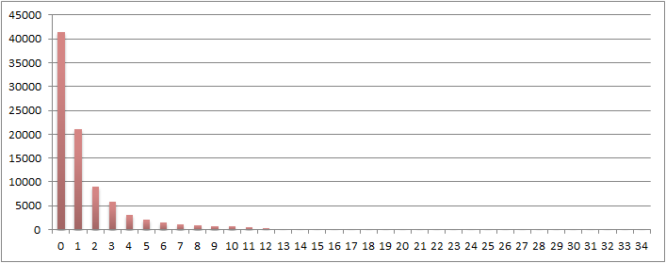

Uses of 3rd-party Libraries
Number of apps
Bundled with 31 libraries,
22 of them are for ad
Number of 3rd-party libraries bundled
Mean=1.59, SD=2.82, Median=1

Slide 24
Categories of 3rd-Party Libraries (Top 400)
Targeted Ads | Mobile Analytics
SNS | Utility
Customized UI Component | Content Host
Game Engine | Secondary Market
Payment

Slide 25
Permission Breakdown by Purpose
 | Internal Use | Targeted Ads | Mobile Analytics | SNS
INTERNET | 41.33% | 47.48% | 20.71% | 16.30%
LOCATION | 17.48% | 72.94% | 26.08% | 6.07%
PHONE_STATE | 24.55% | 74.40% | 16.04% | 6.35%
READ_CONTACTS | 52.07% | 45.76% | - | 2.81%
BLUETOOTH | 86.54% | - | - | -
SMS | 63.33% | 38.81% | - | 1.19%
GET_ACCOUNTS | 32.51% | 4.95% | - | 8.04%
CAMERA | 30.06% | 17.45% | - | -
RECORD_AUDIO | 91.91% | 9.51% | - | -

Slide 26
Identify Patterns in App Behaviors
Objectives
Provide a new way to organize mobile apps
Understand common patterns in usage of sensitive resources
Identify privacy concerns for different types of apps

Slide 27
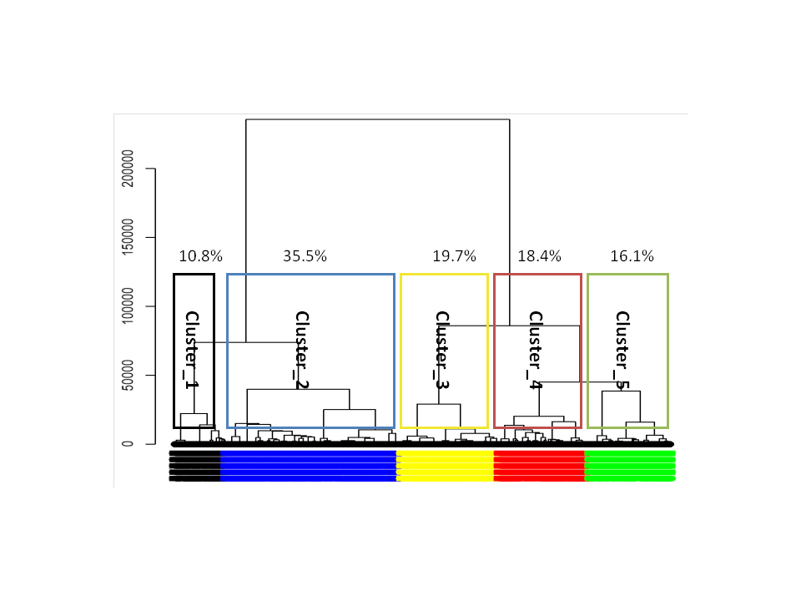
Hierarchical Clustering of Apps
Experiment 4 distance functions, 4 agglomerative methods, and vary k from 2-20 → 304 combinations
Dendrogram of hierarchical clustering with Canberra distance and Ward’s method when k=5

Slide 28
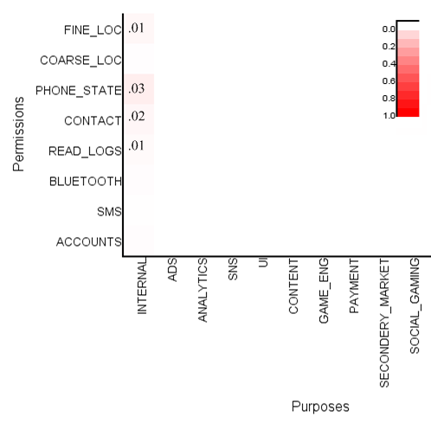
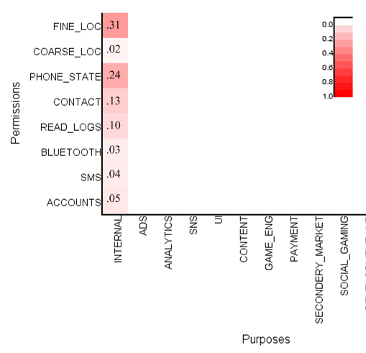
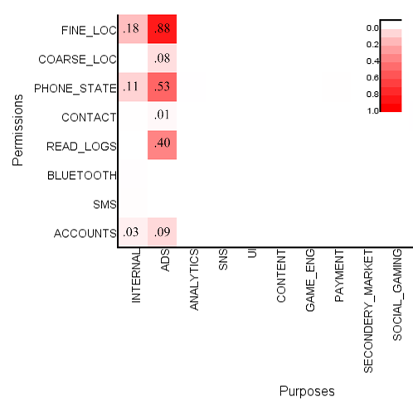
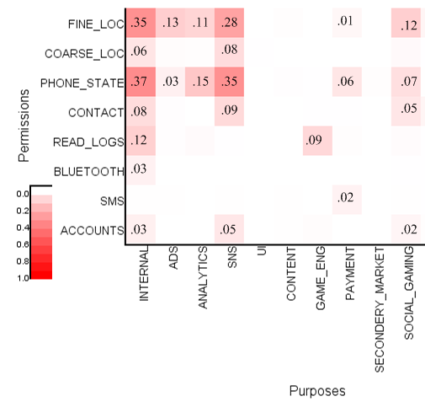
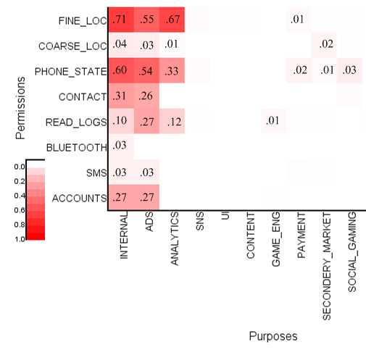
Characteristics of Each Cluster
10.8%
Need no permission
35.5%
No 3rd-party libs
19.7%
Powered by ads
18.4%
Promote SNS sharing
16.1%
Multi-purpose

Slide 29
Characteristics of Each Cluster
10.8%
Need no permission
35.5%
No 3rd-party libs
19.7%
Powered by ad
18.4%
Promote SNS sharing
16.1%
Multi-purpose

Slide 30



Cluster 3 – Ad powered (19.70%)
Mouse, HD wallpapers Live,
Tunee Music
Sensitive resources used mainly for delivering ads
Privacy risks: information aggregation by ad agencies

Slide 31
Characteristics of Each Cluster
10.8%
Need no permission
35.5%
No 3rd-party libs
19.7%
Powered by ad
18.4%
Promote SNS sharing
16.1%
Multi-purpose

Slide 32



Cluster 5– Multi-purposes (16.10%)
IMDb,
Pandora Radio,
Skype
Permissions consumed for multiple purposes
Deep penetration of mobile analytics

Slide 33
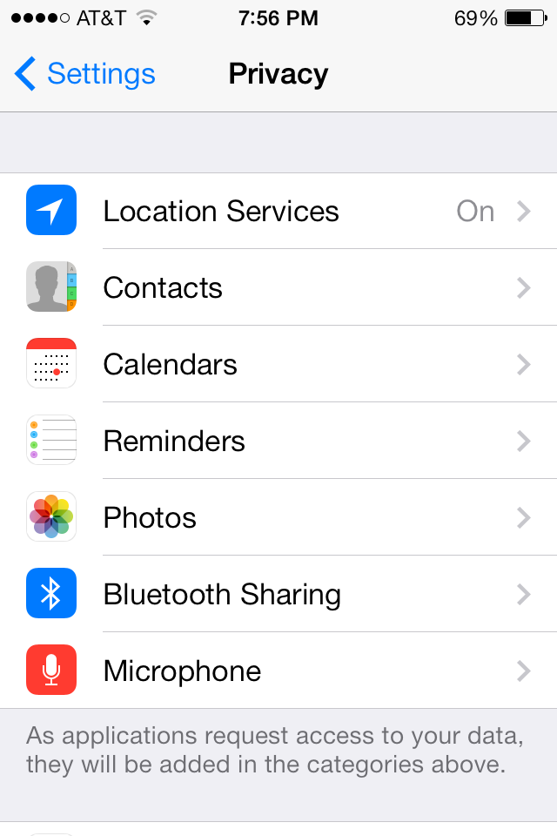
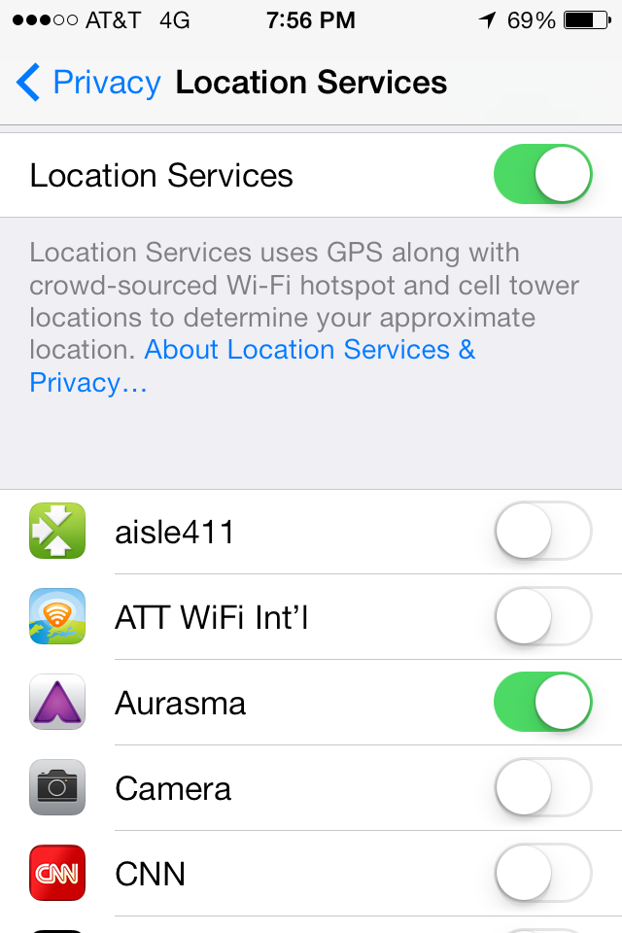
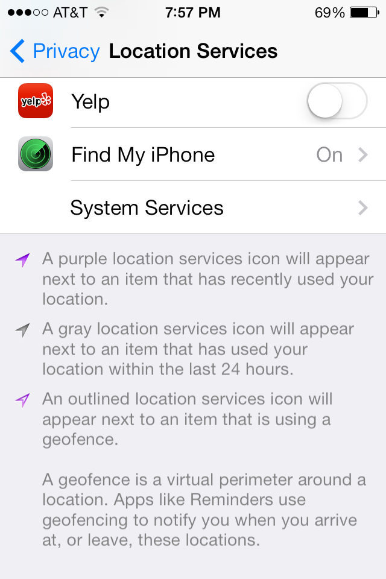
Explosion in Number of Privacy Settings (iOS)
A few iOS7 privacy screens – not even all location permission screens!

Slide 34
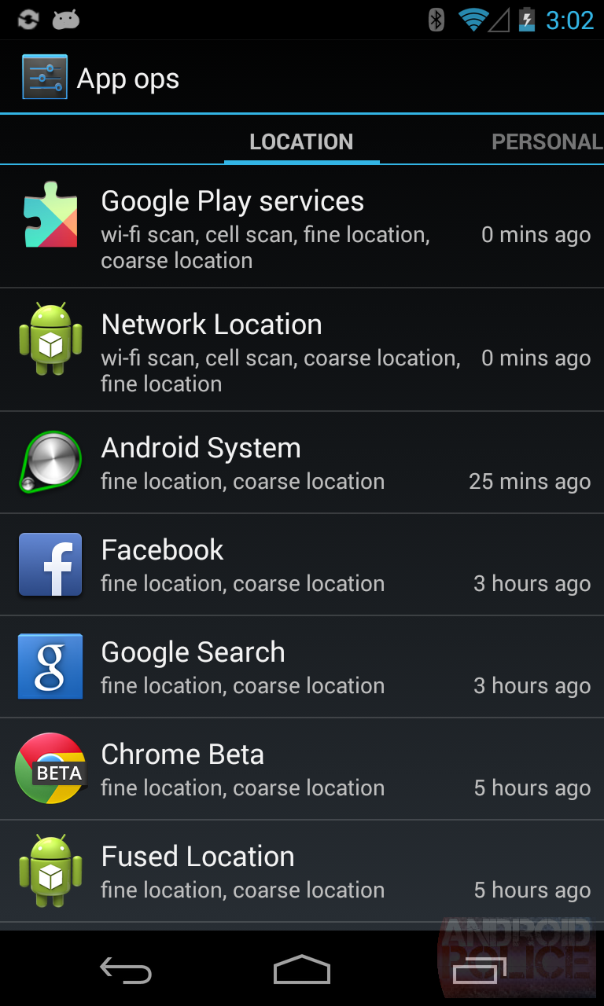
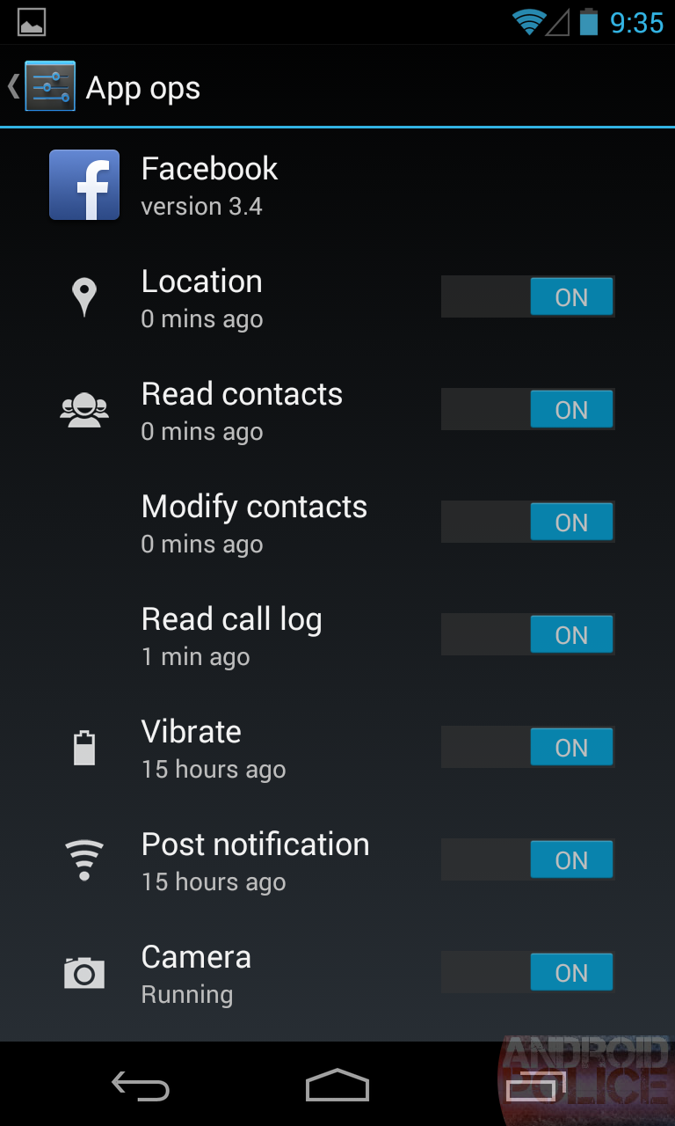
Explosion in Number of Privacy Settings (Android)
Android App Ops Hidden Permission Manager (introduced in Android 4.3)

Slide 35
Are All these Settings Good or Bad?
In many ways, iOS and Android deserve credit for adding all these settings and providing all this information
Yet, the number of settings users are expected to manage is unrealistically high
A user with 40 apps and 3 permissions per app would have to manage 120 permissions!
The information provided does not explain how sensitive data/functionality is used
Issue of purpose is central to people’s preferences

Slide 36
Data Collection
Amazon Mechanical Turk, June 15 – June 30, 2013
Total 725 U.S. smartphone users participated
1200 HITs regarding to 837 mobile apps
One HIT talks about one app, one permission, one purpose triple
We eliminated HITs with less than 15 responses -->total 21, 657 responses

Slide 37
Participants
(a) Gender
(b) Age
(c) Education

Slide 38
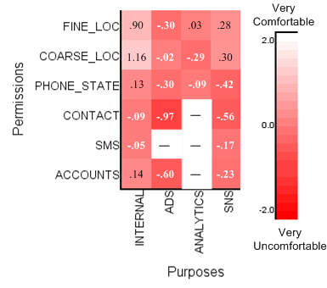
Android Permissions: Purpose Matters!
Users’ Average Preferences
White → comfortable
Red → uncomfortable
J. Lin, “Understanding and Capturing People’s Mobile App Privacy Preferences”, CMU-CS-13-127, October 2013

Slide 39
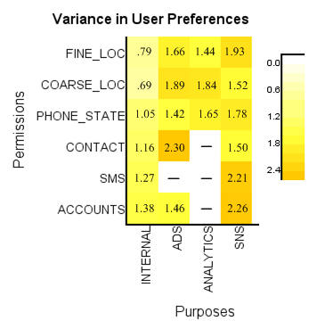
Do All Users Feel the Same Way?
Users’ Average Preferences
White → comfortable
Red → uncomfortable
Variances among Users
Darker yellow → larger variance

Slide 40
Could we possibly identify a small number of clusters of like-minded users?
Could we define a small number of privacy profiles that could help predict a user’s privacy preferences?

Slide 41
Hierarchical Clustering
Canberra distance with average linkage method with k=4

Slide 42
How Do These Clusters Differ?

Slide 43
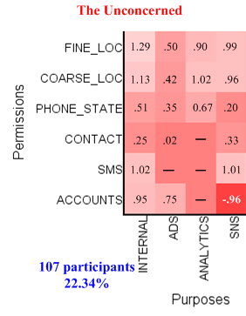
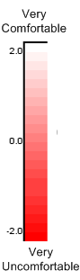
The Unconcerned
Generally open to all types of disclosure
The very red grid on the bottom right might be caused by lack of data

Slide 44
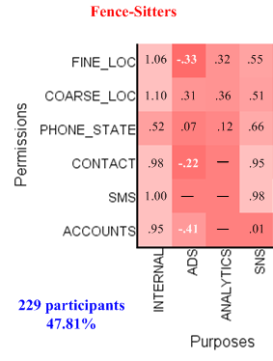
Fence-Sitters
Largest group of users (47.81%)
Express neutral opinions for lots of cases (light colors)
Might be the result of warning fatigue (habitation effect)

Slide 45
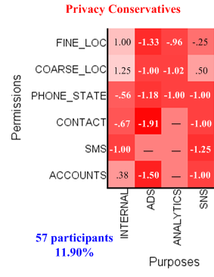
Conservatives
Uncomfortable letting external libraries access their information
Even for accessing contact list, SMS or unique phone ID for the app’s own use

Slide 46
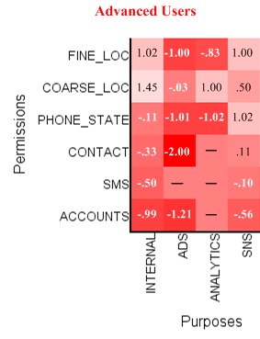
Advanced Users
Appear to be conservative too, but more selective
Don’t like ads and mobile analytics
But OK with disclosing coarse location information
OK with SNS
17.95% users

Slide 47
Select Privacy Profile
Asking users a set of general questions
Notes:
“How do you feel letting mobile apps access your personal data for delivering targeted ads?”
“How do you feel letting mobile apps sending your approximate location for market analysis purpose?”

Slide 48
Theoretical Bounds on Predicting Individual’s Privacy Preferences
Baseline: Using grand average
Q1: Only ask one question
Q1..Qn: A perfect set of questions that can differentiate four privacy profiles
Notes:
Q1: users were asked only 1 question that separate them into two groups, group1(advanced users, conservatives), group2 (fence-sitters, unconcerned)
Q1..Qn: assume we found a perfect set of questions that can accurately classify users into the four clusters.

Slide 49
How About Hybrid Solutions?
Prediction + Interaction
B. Liu, J. Lin, N. Sadeh “Reconciling Mobile App Privacy and Usability on Smartphones: Could User Privacy Profiles Help?”, October 2013, Under review.

Slide 50
LBE Privacy Guard
Fine-grained control of Android Permissions.
Available on rooted Android phones.
Managing 12 Permissions:
“Send SMS”, “Phone Call”, “Phone State”, “Call Monitoring”, “SMS DB”, “Contact”, “Call Logs”, “Positioning”, “Phone ID”, “3G Network”, “Wi-Fi Network” and “ROOT”.
Settings that users can choose:
“Allow”, “Deny”, “Ask”

Slide 51
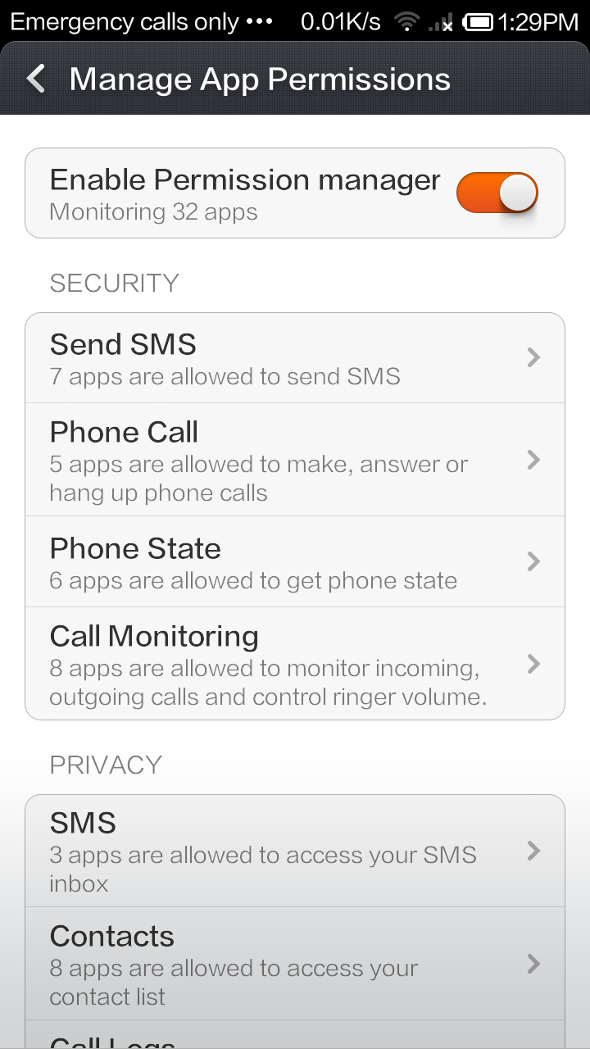
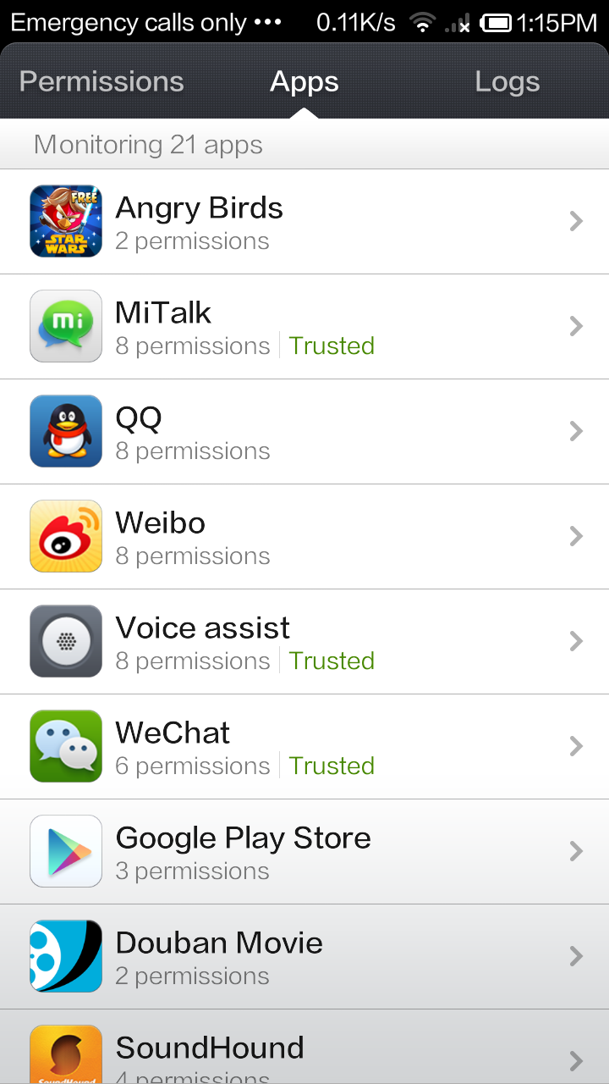
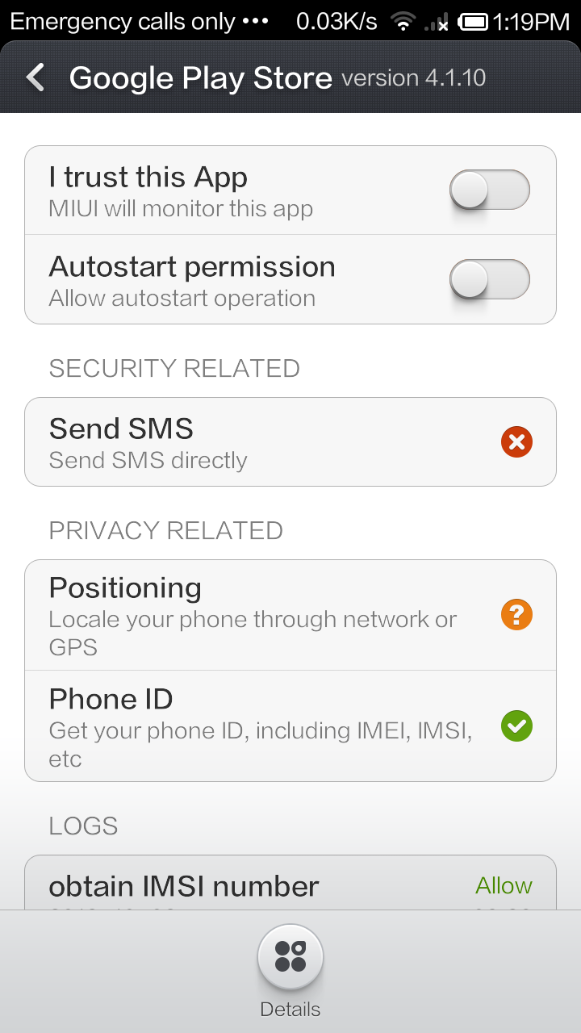

Slide 52
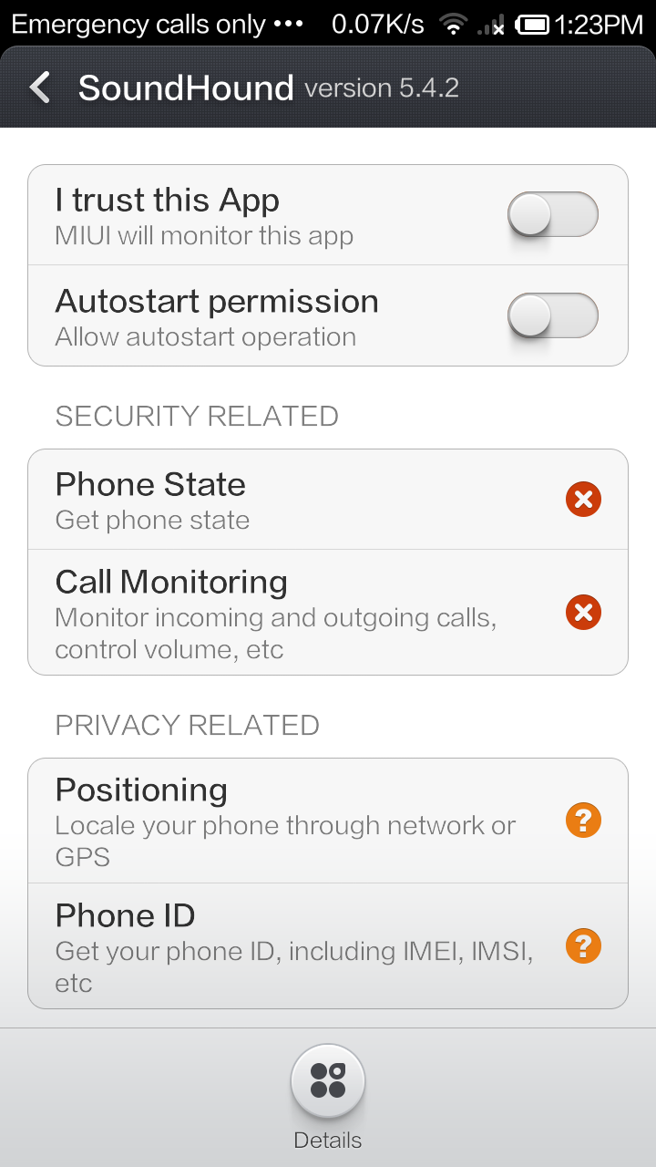
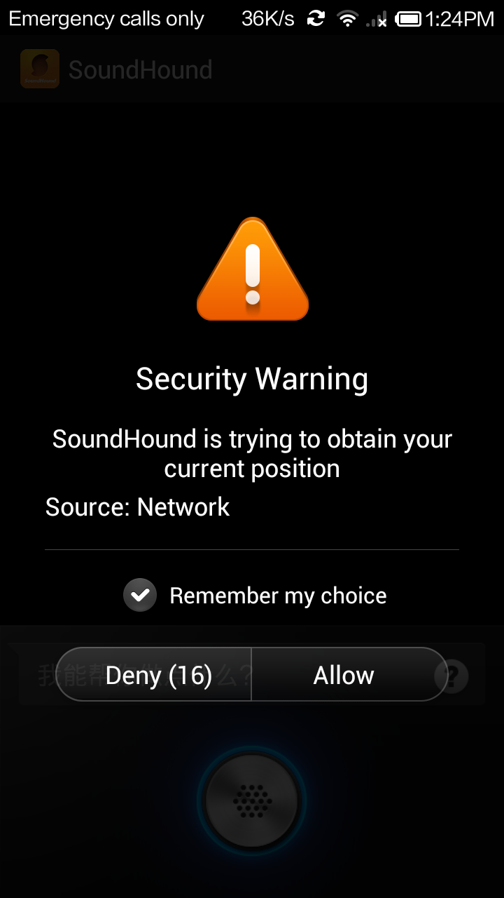

Slide 53
LBE Data Set
Log records from LBE users
Log including all apps installed with decisions of each requested permission
Uploaded daily with latest settings
10-day subset.
4.8M users, 501K apps,
159M decision records, 118M unique {user, app, permission, decision} triples

Slide 54
Data Preprocessing
We want users to be
active users
users who made “Deny” / “Ask” decisions at least once.
Focused on
popular apps
available in Google Play store
App-permission pairs with sufficient data points
239K users, 12K apps, 28M records

Slide 55
Diversity of users’ preferences
22.66 apps per user
3.19 common apps per pair of users
3.03 permissions per app
Agreement of users’ decisions:
63.9% of app-permission pairs have 80% agreement.
(If we consider pairs with >= 5 users,
the percentage drops to 51.4%)
Notes:
----- Meeting Notes (10/28/13 12:05) -----
Threshold here is 80%. PMP use 60% ~ 70%.

Slide 56
Predicting settings for each user
f: {user, app, permission} → decision
Predicting “Allow” and “Deny”.
Large-scale corpus:
239K users, 12K apps, 14.5M records
Split of training & testing on users
Training set: users’ decisions are all known
Testing set: users’ decisions of only 20% of their apps are known
10-fold cross validation
Linear-kernel SVM
L2-loss dual SVM classification

Slide 57
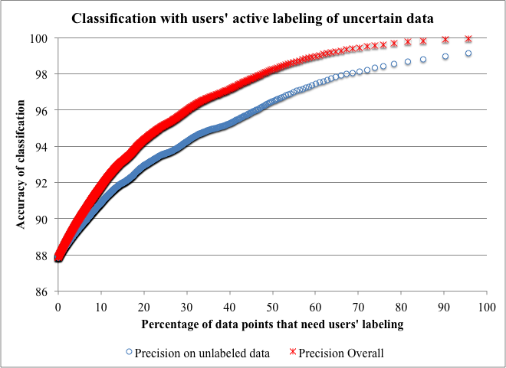
Pure Prediction vs. Interactive Model
With more labeling of users, we can increase the accuracy of our predictions.
If users can label an additional 10% of their permission decisions, the prediction accuracy will climb from 87.8% to 91.8%...and that’s only 6 questions…
At 20% (about 12 questions), accuracy climbs to 94%!

Slide 58
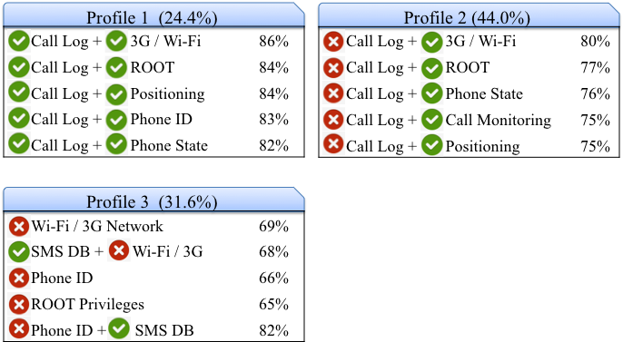
And Profiles Can Help too (e.g. K=3)
Profile Descriptions & Heat map of users’ average decisions
when K=3

Slide 59
Concluding Remarks
Mobile App Security and Privacy is critical to the reputation of app stores
Complex data flows & complex value chain
Long-term goal: Intelligent privacy assistants
Help scale to interactions with a large number of apps and services
Learn user preferences
Can selectively enter in dialogues with users and nudge them towards safer practices

Slide 60
References
Required: These slides

Slide 61
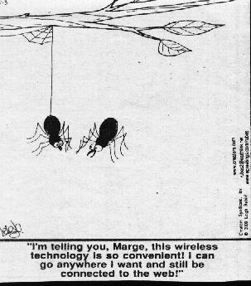
Q&A
Source:
http://www.rudezone.com/cartoon4/wireless.html

